Slide 1
This slide is hidden.
Insert the starting slides after this slide

Slide 2

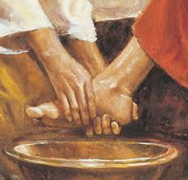
Welcome to the Mass of the
Lord’s Supper
Please ensure all mobile phones are switched off.
Please be respectfully quiet as we prepare for our Celebration.
Notes:
Saturday 5.30PM First Sunday of Advent

Slide 3
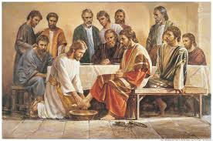
Jesus poured water into a basin and began to wash the disciples' feet …

Slide 4
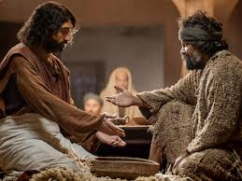
Peter said, 'You shall never wash my feet.'

Slide 5
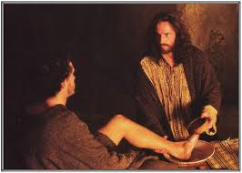
‘I have given you an example so that you may copy what I have done to you.’

Slide 6
How am
I
of service
to others?

Slide 7
This slide is hidden.
Insert the Entrance Hymn after this slide

Slide 8
When I survey the wondrous cross
(Isaac Watts)
When I survey the wondrous cross
On which the Prince of glory died,
My richest gain I count but loss,
And pour contempt on all my pride.
Licence No. CCLI 312895

Slide 9
Forbid it, Lord, that I should boast,
Save in the death of Christ my God!
All the vain things that charm me most,
I sacrifice them to His blood.
Licence No. CCLI 312895

Slide 10
See from His head, His hands, His feet,
Sorrow and love flow mingled down!
Did e’er such love and sorrow meet,
Or thorns compose so rich a crown?
Licence No. CCLI 312895

Slide 11
Were the whole realm of nature mine,
That were a present far too small;
Love so amazing, so divine,
Demands my soul, my life, my all.
Licence No. CCLI 312895

Slide 13
See the oils
(Christopher Willcock)
See, see the oil of the sick
The pow'r of the Spirit
The prayer of the Church
Have come down upon this oil
To comfort and heal those who are sick
Licence No. CCLI 312895

Slide 14
Blessed are you, Lord our God
Whose touch renews our lives
Blessed are you O Lord our God
Whose strength confirms our hearts
Licence No. CCLI 312895

Slide 15
See, see the oil of catechumens
The pow'r of the Spirit
The prayer of the Church
Have come down upon this oil
To fortify those preparing for baptism
Licence No. CCLI 312895

Slide 16
Blessed are you, Lord our God
Whose touch renews our lives
Blessed are you O Lord our God
Whose strength confirms our hearts
Licence No. CCLI 312895

Slide 17
See, see the oil of chrism
The pow'rof the Spirit
The prayer of the Church
Have come down upon this oil
To seal with the spirit
Those washed in baptism
Licence No. CCLI 312895

Slide 18
Blessed are you, Lord our God
Whose touch renews our lives
Blessed are you O Lord our God
Whose strength confirms our hearts
Licence No. CCLI 312895

Slide 20
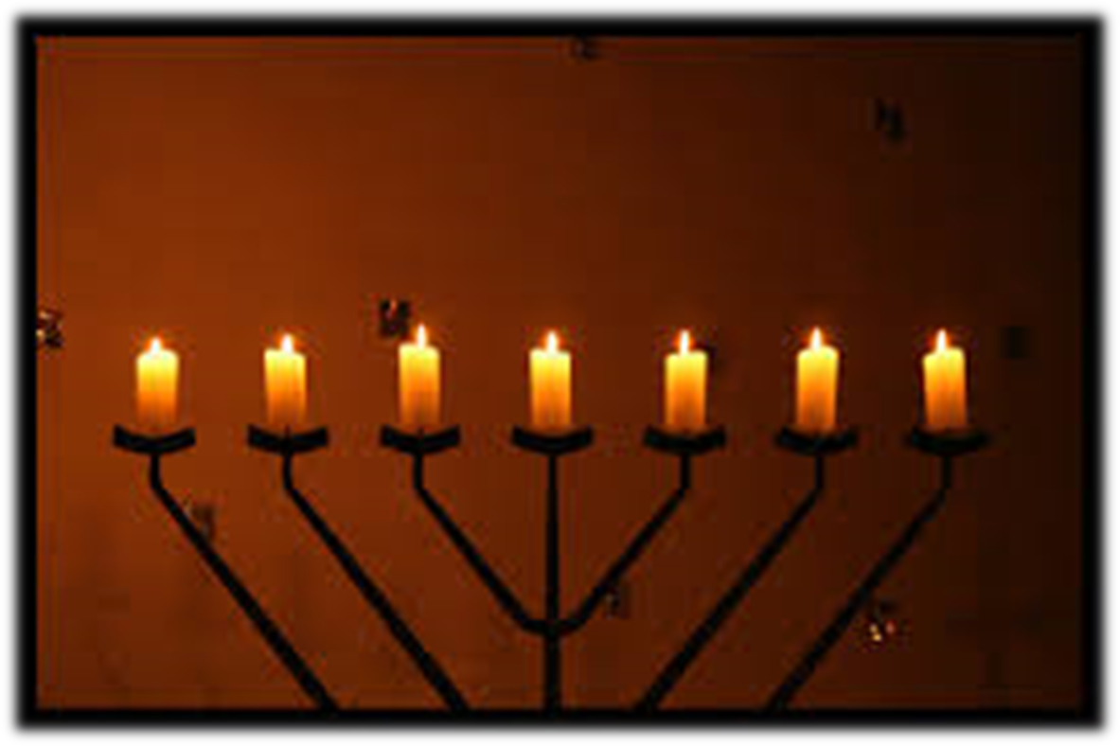
Lighting of the Menorah

Slide 21
Havenu shalom aleikhem
Havenu shalom aleikhem
Havenu shalom aleikhem
Havenu shalom, shalom
Shalom aleikhem
Licence No. CCLI 312895

Slide 22
Gloria
Glory to God in the highest,
and on earth peace to people of good will.
We praise you, we bless you,
we adore you, we glorify you,
Licence No. CCLI 312895

Slide 23
We give you thanks for your great glory,
Lord, God heavenly king,
O God, almighty father
Licence No. CCLI 312895

Slide 24
Glory to God in the highest,
and on earth peace to people of good will.
Licence No. CCLI 312895

Slide 25
Lord Jesus Christ, Only Begotten Son,
Lord God, Lamb of God, Son of the Father,
you take away the sins of the world,
have mercy on us;
Licence No. CCLI 312895

Slide 26
you take away the sins of the world, receive our prayer;
you are seated at the right hand of the Father,
have mercy on us.
Licence No. CCLI 312895

Slide 27
Glory to God in the highest,
and on earth peace to people of good will.
Licence No. CCLI 312895

Slide 28
For you alone are the Holy One,
you alone are the Lord,
you alone are the Most High, Jesus Christ,
with the Holy Spirit,
in the glory of God the Father.
Licence No. CCLI 312895

Slide 29
Glory to God in the highest,
and on earth peace to people of good will.
Amen.
Licence No. CCLI 312895

Slide 31
Responsorial Psalm
Our blessing cup is a communion
With the blood of Christ
Licence No. CCLI 312895

Slide 33
Alleluia
Alleluia, alleluia,
alleluia, alleluia
Licence No. CCLI 312895

Slide 34
Alleluia
Glory and praise to you, Lord Jesus Christ (2)
Licence No. CCLI 312895

Slide 35
Christ Became Obedient unto death
Unto death a death upon the cross
Therefore God has raised Him to the heights
Giving Him a name above all names.
Music: Aniceto Nazareth
Licence No. CCLI 312895

Slide 36
Glory and praise to you, Lord Jesus Christ (2)
Licence No. CCLI 312895

Slide 38
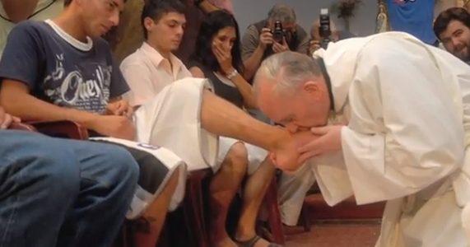
WASHING OF FEET

Slide 39
The servant song
(Richard Gillard)
Brother let me be your servant
Let me be as Christ to you
Pray that I may have the grace to
Let you be my servant too
Licence No. CCLI 312895

Slide 40
We are pilgrims on a journey
We are brothers on the road
We are here to help each other
Walk the mile and bear the load
Licence No. CCLI 312895

Slide 41
I will weep when you are weeping
When you laugh I'll laugh with you
I will share your joys and sorrows
Till we've seen this journey through
Licence No. CCLI 312895

Slide 42
When we sing to God in heaven
We shall find such harmony
Born of all we've known together
Of God's love and agony
Licence No. CCLI 312895

Slide 43
Brother let me be your servant
Let me be as Christ to you
Pray that I may have the grace to
Let you be my servant too
Licence No. CCLI 312895

Slide 44
A new commandment
A new commandment I give unto you
That you love one another as I have loved you
That you love one another as I have loved you
Licence No. CCLI 312895

Slide 45
By this shall all men know you are my disciples
If you have love one for another
By this shall all men know you are my disciples
If you have love one for another
Licence No. CCLI 312895

Slide 46
A new commandment I give unto you
That you love one another as I have loved you
That you love one another as I have loved you
Licence No. CCLI 312895

Slide 47
You are my friends if you do as I command you
Without my help you can do nothing
You are my friends if you do as I command you
Without my help you can do nothing
Licence No. CCLI 312895

Slide 48
A new commandment I give unto you
That you love one another as I have loved you
That you love one another as I have loved you
Licence No. CCLI 312895

Slide 50
Apostles Creed
I believe in God,
the Father almighty,
Creator of heaven and earth,
and in Jesus Christ, his only Son, our Lord,
(At the words that follow, up to and including the Virgin Mary, all bow.)

Slide 51
who was conceived by the Holy Spirit,
born of the Virgin Mary,
suffered under Pontius Pilate,
was crucified, died and was buried;
he descended into hell;

Slide 52
on the third day he rose again from the dead;
he ascended into heaven,
and is seated at the right hand of God the Father almighty;

Slide 53
from there he will come to judge the living and the dead.
I believe in the Holy Spirit,
the holy catholic Church,

Slide 54
the communion of saints,
the forgiveness of sins,
the resurrection of the body,
and life everlasting.
Amen.

Slide 56
This slide is hidden.
Insert the Offertory Hymn after this slide.

Slide 57
Ubi Caritas
Ubi caritas et amor
Ubi caritas Deus ibiest
Licence No. CCLI 312895

Slide 58
Bless the Lord, my soul
And bless God's holy name
Bless the Lord, my soul
Who leads me into life
Licence No. CCLI 312895

Slide 60
Priest: Pray my brothers and sisters,
that my sacrifice and yours may be
acceptable to God, the almighty Father.
All: May the Lord accept the sacrifice
at your hands for the praise and glory of his name, for our good and the good of all his holy Church.

Slide 61
Priest: The Lord be with you.
All: And with your spirit.
Priest: Lift up your hearts.
All: We lift them up to the Lord.

Slide 62
Priest: Let us give thanks to the
Lord our God.
All: It is right and just.

Slide 64
Holy
Holy, Holy, Holy Lord God of hosts,
Heaven and earth are full of your glory. Hosanna in the highest
Blessed is he who comes
in the name of Lord,
Hosanna in the highest.
Licence No. CCLI 312895

Slide 66
Memorial acclamation
Save us saviour of the world,
For by your cross and resurrection,
You have set us free
Licence No. CCLI 312895

Slide 67
Memorial acclamation
When we eat this bread
And drink this cup
We proclaim your death O Lord
Until you come again
Licence No. CCLI 312895

Slide 68
Memorial acclamation
We proclaim your death O Lord
And profess your resurrection
Until you come again
Licence No. CCLI 312895

Slide 70
Amen
Amen, amen, amen, amen.
Amen, amen, amen, amen.
Licence No. CCLI 312895

Slide 72
Priest: The Lord be with you.
All: And with your spirit

Slide 74
Peace
May the peace of the Lord be with you
With your friends and your family too
Let it be, let it grow
And everywhere you go
May the peace of the Lord follow you
Licence No. CCLI 312895

Slide 75
Lamb of God
Lamb of God, lamb of God
You take away the sins of the world
Have mercy on us, lamb of God
Licence No. CCLI 312895

Slide 76
Lamb of God, lamb of God
You take away the sins of the world
Have mercy on us, lamb of God
Licence No. CCLI 312895

Slide 77
Lamb of God, lamb of God
You take away the sins of the world
Grant us, grant us peace
Licence No. CCLI 312895

Slide 79
Priest: Behold the Lamb of God, behold him who takes away the sins of the world.
Blessed are those called to the supper of the Lamb.
All: Lord, I am not worthy that you should enter under my roof, but only say the word and my soul shall be healed.

Slide 80
This slide is hidden.
Insert the Communion Hymns after this slide.

Slide 81
Ave Verum
(Wolfgang Amadeus Mozart)
Ave, verum
Corpus natum
De Maria Virgine
Licence No. CCLI 312895

Slide 82
Vere passum immolatum
in Cruce pro homine,
Cujus latus perforatum
unda fluxit et sanguine,
Licence No. CCLI 312895

Slide 83
Esto nobis praegustatum
in mortis examine.
In mortis examine.
Licence No. CCLI 312895

Slide 84
Lamb of God
(Words & Music: Twila Paris)
Your only Son, no sin to hide
But You have sent Him,
From Your side
To walk upon this guilty sod
And to become the Lamb of God
Licence No. CCLI 312895

Slide 85
Your gift of Love they crucified
They laughed and scorned him as he died
The humble King they named a fraud
And sacrificed the Lamb of God
Licence No. CCLI 312895

Slide 86
Oh Lamb of God, Sweet lamb of God
I love the Holy Lamb of God
Oh wash me in His precious Blood
My Jesus Christ the Lamb of God
Licence No. CCLI 312895

Slide 87
I was so lost I should have died
But You have brought me to Your side
To be led by Your staff and rod
And to be called a lamb of God
Licence No. CCLI 312895

Slide 88
Oh Lamb of God, Sweet lamb of God
I love the Holy lamb of God
Oh wash me in His precious Blood
Till I am just a lamb of God
Licence No. CCLI 312895

Slide 89
Oh lamb of God, Sweet lamb of God
I love the Holy lamb of God
Oh wash me in His precious Blood
Till I am just a lamb of God
Licence No. CCLI 312895

Slide 90
Make me like you
(Jimmy & Carol Owens)
Lord make me like you
Please make me like you
You are a servant
Make me one too
Licence No. CCLI 312895

Slide 91
O Lord I am willing
Do what you must do
To make me like you, Lord
Please make me like you
Licence No. CCLI 312895

Slide 92
Lord make me like you
Please make me like you
You are a servant
Make me one too
Licence No. CCLI 312895

Slide 93
O Lord I am willing
Do what you must do
To make me like you, Lord
Please make me like you
Licence No. CCLI 312895

Slide 94
Whatever you do, Lord
Please make me like you
Licence No. CCLI 312895

Slide 96
Stay with me
Stay with me
Remain here with me
Watch and pray
Watch and pray
Licence No. CCLI 312895

Slide 97
Jesus remember me
Jesus remember me
When you come into your kingdom
Jesus remember me
When you come into your kingdom
Licence No. CCLI 312895

Slide 98
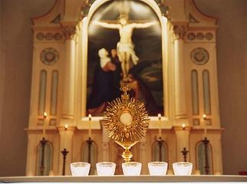
X
SILENCE PLEASE
You are welcome to follow the procession silently into the Hall and watch and pray.
The Altar of Repose will be available for prayer until 10pm when we will finish with Night Prayer at 10pm.

Slide 99
This slide is hidden.
The next slide can be used for videos.
Insert the video into the slide.

Slide 101
This slide is hidden.
Insert the Recessional Hymns after this slide.

Slide 102
This slide is hidden.
Insert the final slide here.

